Slide 1


Introduction to Electronics & Semiconductor Technology
Course Code:ESV10010

Slide 2
UNIT I - A.C. CIRCUITS

Slide 3
Contents
A.C. Circuits: Generation of alternating EMF, Equation of alternating quantity, waveforms, Concept of impedance, admittance, Series RL, RC, RLC circuits, Series resonance, Single Phase Transformer working principle. [7L]

Slide 4
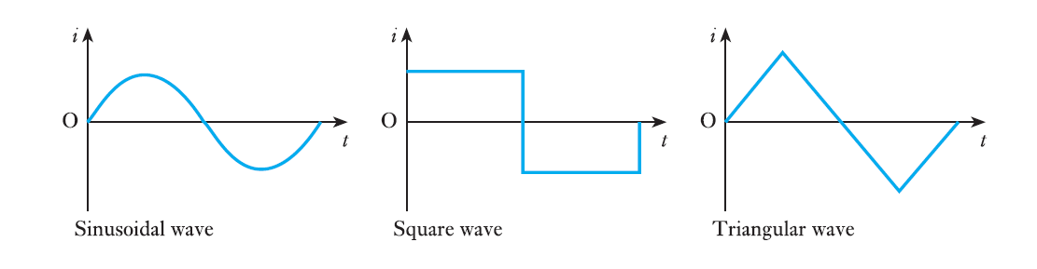
Alternating systems
Alternating current can be abbreviated to a.c., hence a system with such an alternating current is known as an a.c. system. The curves relating current to time are known as waveforms.

Slide 5
An A.C. generator is an electronic device used to convert mechanical energy into electrical energy using the principle of electromagnetic induction.
AC generators work on the principle of Faraday's law of electromagnetic induction. When the armature rotates between the magnet's poles upon an axis perpendicular to the magnetic field, the flux linkage of the armature changes continuously. Due to this, an emf is induced in the armature.

Slide 6
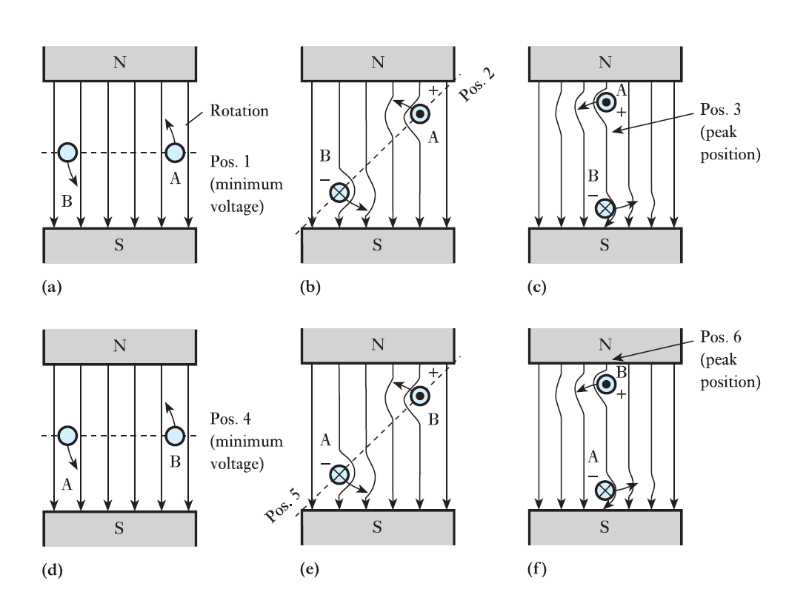
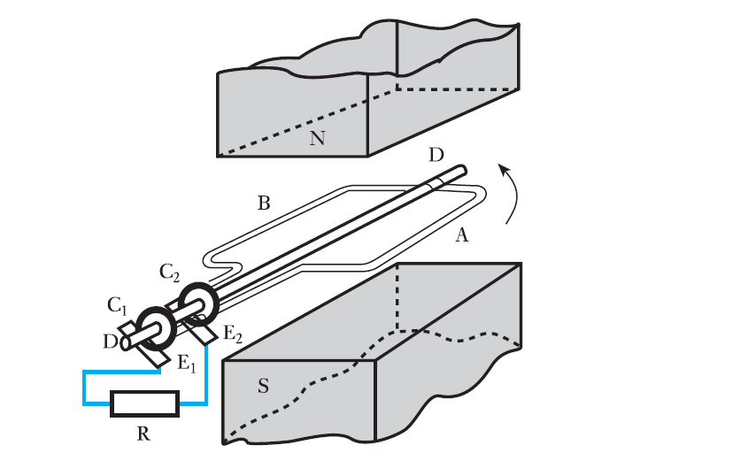
Generation of an alternating e.m.f.
3D animation link- https://youtu.be/gQyamjPrw-U
Fig. Generation of an alternating e.m.f. Fig. EMF in rotating coil

Slide 7
Explanation
The Figure shows a loop AB carried by a spindle DD rotated at a constant speed in an anticlockwise direction in a uniform magnetic field due to poles NS.
The ends of the loop are brought out to two slip-rings C1 and C2,attached to but insulated from DD.
Bearing on these rings are carbon brushes E1 and E2, which are connected to an external resistor R.
Since the coil sides are moving in opposite directions, the e.m.f.s act in opposite directions, as shown by the dot and cross notation.
However, they do act in the same direction around the coil so that the e.m.f. which appears at the brushes is twice that which is induced in a coil side.

Slide 8
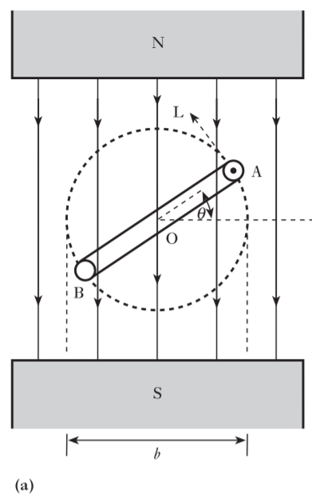
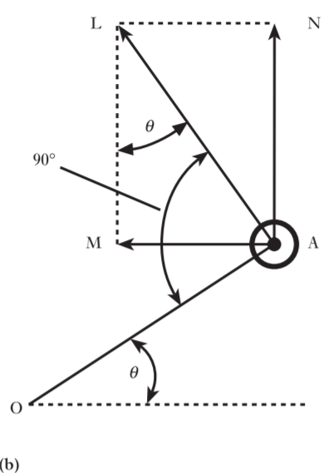
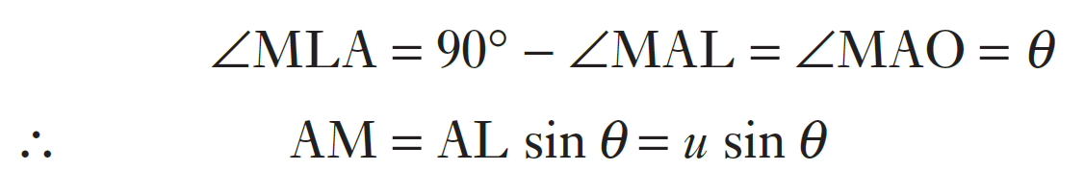
Generation of an alternating e.m.f.
In Fig. (a), coil AB is shown after it has rotated through an angle θ from the horizontal position, namely the position of zero e.m.f.
Suppose the peripheral velocity of each side of the loop to be u metres per second; then at the instant shown in Fig., this peripheral velocity can be represented by the length of a line AL drawn at right angles to the plane of the loop.
We can resolve AL into two components, AM and AN, perpendicular and parallel respectively to the direction of the magnetic flux, as shown in Fig. (b).
The e.m.f. generated in A is due entirely to the component of the velocity perpendicular to the magnetic field. (AM=usinθ)
Fig. Instantaneous value of generated e.m.f.

Slide 9
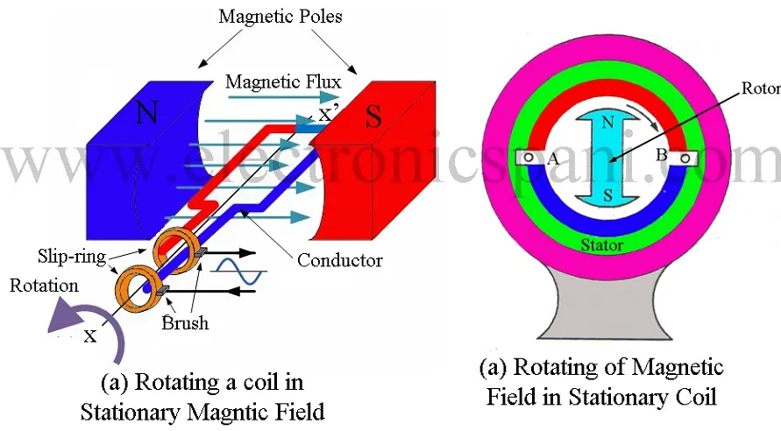

Slide 10
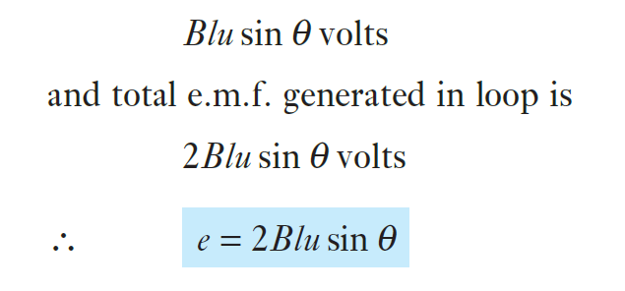
Generation of an alternating e.m.f.
Hence, if B is the flux density in tesla and if l is the length in metres of each of the parallel sides A and B of the loop,
Then, e.m.f. generated in one side of loop is
i.e. the generated e.m.f. is proportional to sin θ
𝐵 is the magnetic flux density, 𝑙 is the length of the conductor (side A), 𝑢 is the velocity of the conductor, sin⁡𝜃 accounts for the angle between the conductor and the magnetic field lines
Generated e.m.f. is proportional to sin θ.

Slide 11
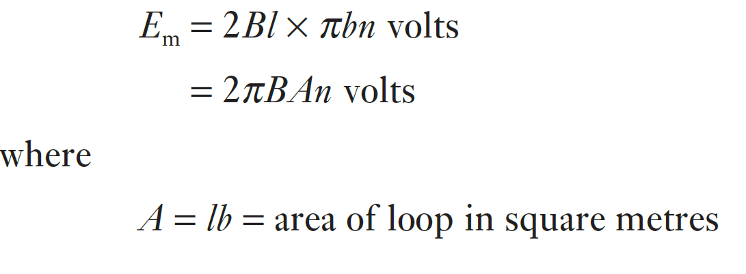
Generation of an alternating e.m.f.
When θ = 90°, the plane of the loop is vertical and both sides of the loop are cutting the magnetic flux at the maximum rate, so that the generated e.m.f. is then at its maximum value Em.
  when θ = 90°, Em = 2Blu volts.
If b is the breadth of the loop in metres, and n the speed of rotation in revolutions per second, then u is πbn metres per second and
u: Linear velocity of the loop’s side, equal to πbn meters per second. This is because the loop is rotating in a circular path, and πb is the circumference that a point on the side of the loop travels in one revolution.

Slide 12
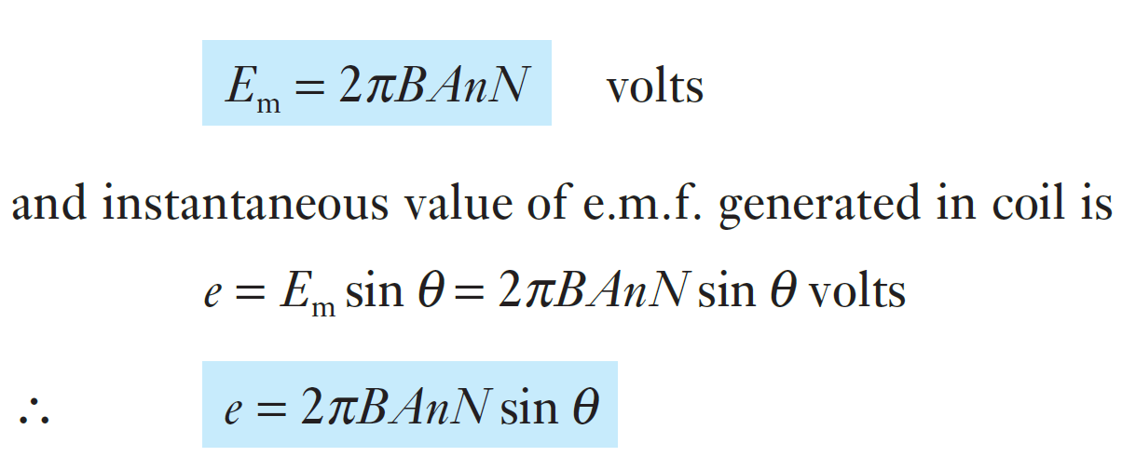
Generation of an alternating e.m.f.
If the loop is replaced by a coil of N turns in series, each turn having an area of A square metres, maximum value of e.m.f. generated in coil is

Slide 13
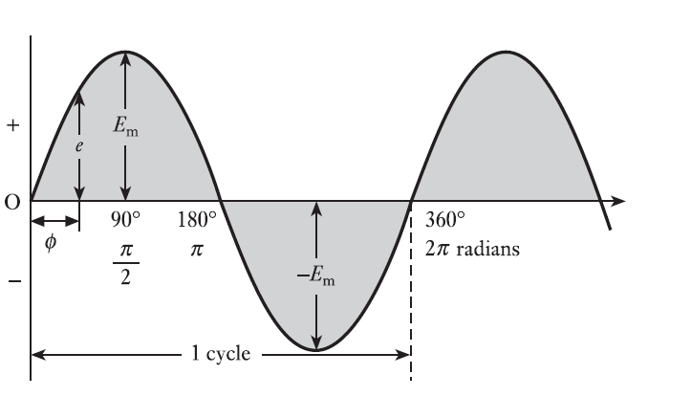
Instantaneous value of generated e.m.f.
Em - maximum value of the e.m.f.
e - value after the loop has rotated through an angle θ from the position of zero e.m.f.
e.m.f. is positive while θ is varying between 0 and 180°.
It is negative while θ is varying between 180° and 360°.
Fig. Sine wave of e.m.f.

Slide 14
Waveform terms and definitions
Waveform: The variation of a quantity such as voltage or current shown on a graph to a base of time or rotation is a waveform.
Cycle: Each repetition of a variable quantity, recurring at equal intervals, is termed a cycle.
Period: The duration of one cycle is termed its period. (Cycles and periods need not commence when a waveform is zero. Figure illustrates a variety of situations in which the cycle and period have identical values.)
Instantaneous value: The magnitude of a waveform at any instant in time (or position of rotation). Instantaneous values are denoted by lower-case symbols such as e, v and i.
Peak value: The maximum instantaneous value measured from its zero value is known as its peak value.
Peak-to-peak value: The maximum variation between the maximum positive instantaneous value and the maximum negative instantaneous value is the
peak-to-peak value. For a sinusoidal waveform, this is twice the peak value. The peak-to-peak value is Epp or Vpp or Ipp.

Slide 15
Definitions
Peak amplitude: The maximum instantaneous value measured from the mean value of a waveform is the peak amplitude. For most sinusoidal alternating voltages and currents the mean value is zero.
The peak amplitude is Em or Vm or Im. The peak amplitude is generally described as the maximum value, hence the maximum voltage has the symbol Vm.
Frequency: The number of cycles that occur in 1 second is termed the frequency of that quantity. Frequency is measured in hertz (Hz)
Frequency f is related to the period T by the relation
f = 1/ T
where f is the frequency in hertz(Hz) and T is the period in seconds.

Slide 16
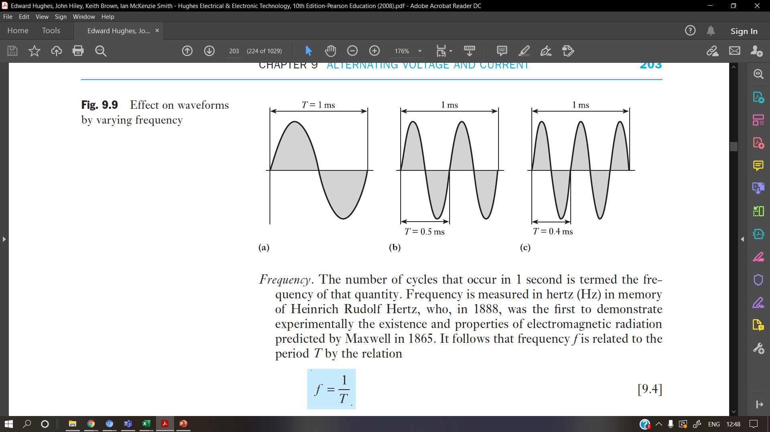
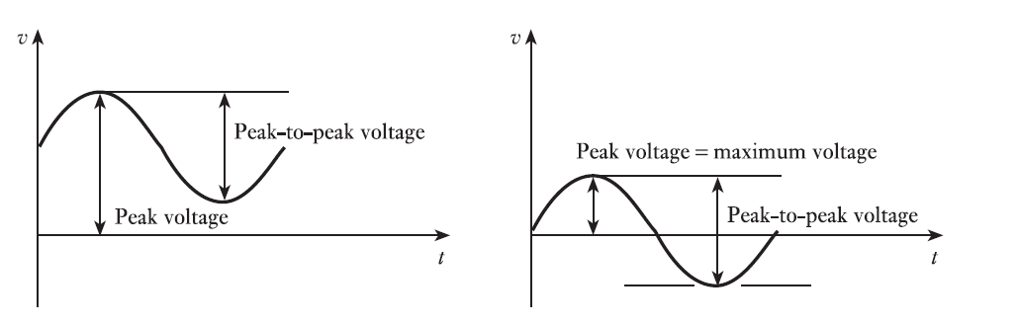
Fig. Cycles and periods,
Effect on waveforms
by varying frequency
The diagrams assume frequencies of 1000 Hz (1 kHz), 2000 Hz (2 kHz) and 2500 Hz (2.5 kHz).
Fig. Peak values

Slide 17
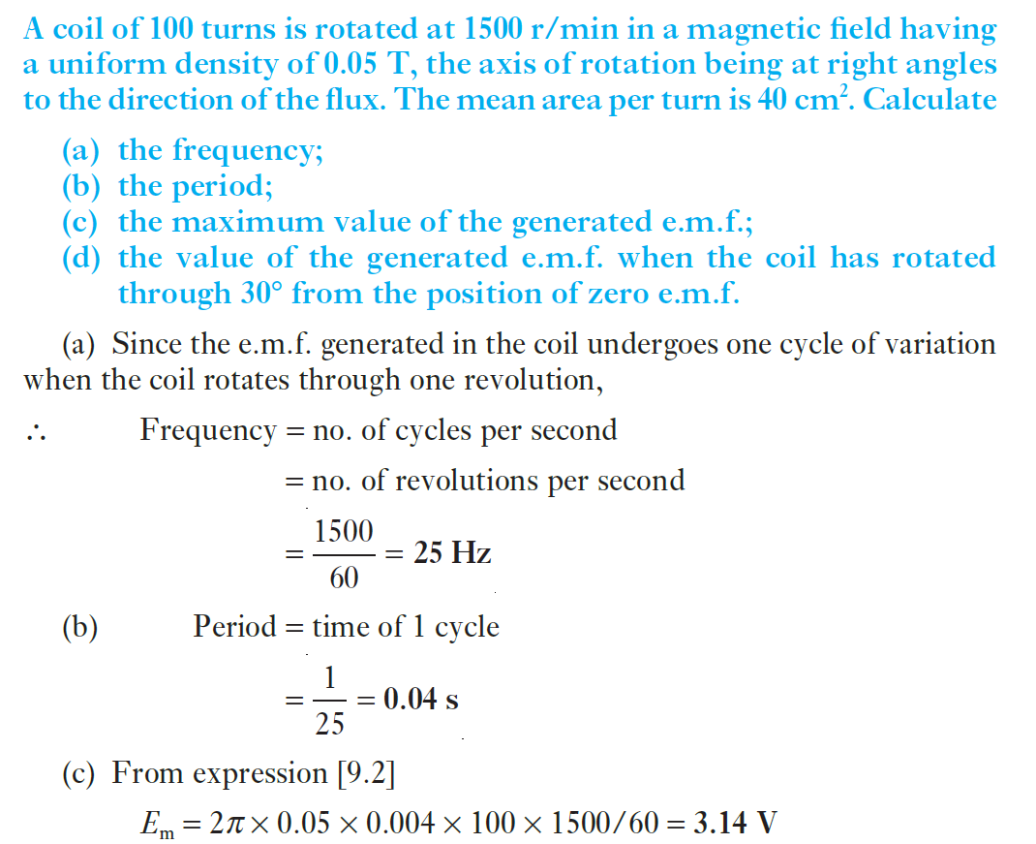
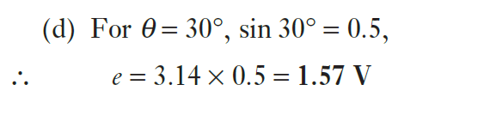
Example 1

Slide 18
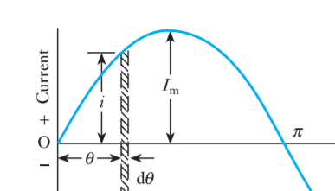
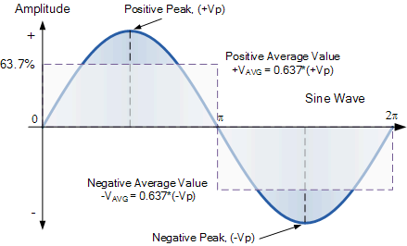
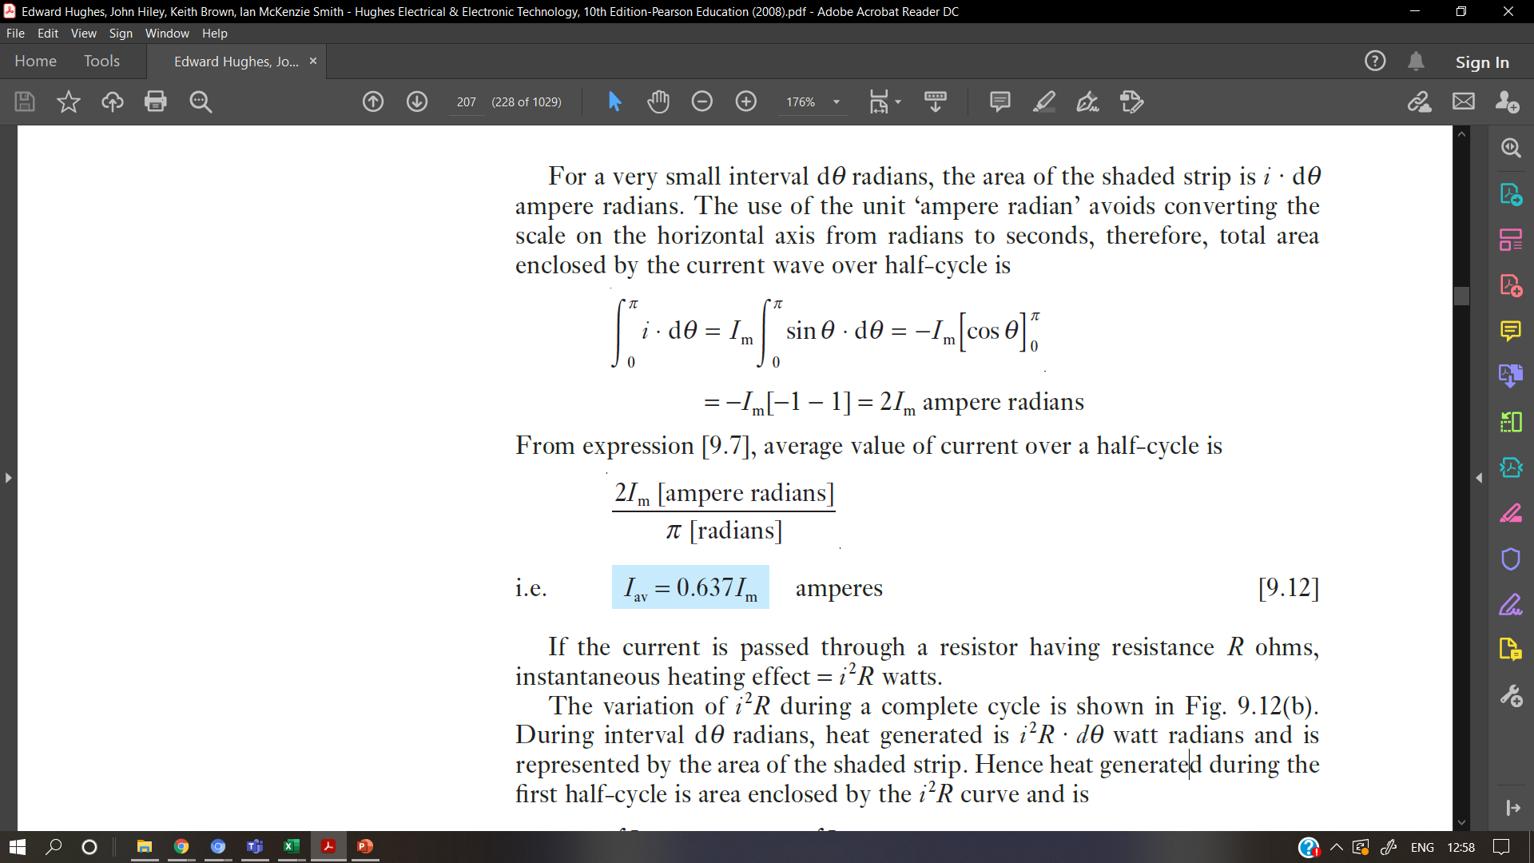
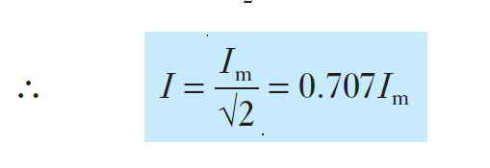
Average and r.m.s. values of sinusoidal currents and voltages
If Im is the maximum value of a current which varies sinusoidally, the instantaneous value i is represented by,
i = I_{m} sinθ
where θ is the angle in radians from instant of zero current.
Therefore, total area enclosed by the current wave over half-cycle is,
Average value of current over a half-cycle is,
RMS value of current over a half-cycle is,

Slide 19
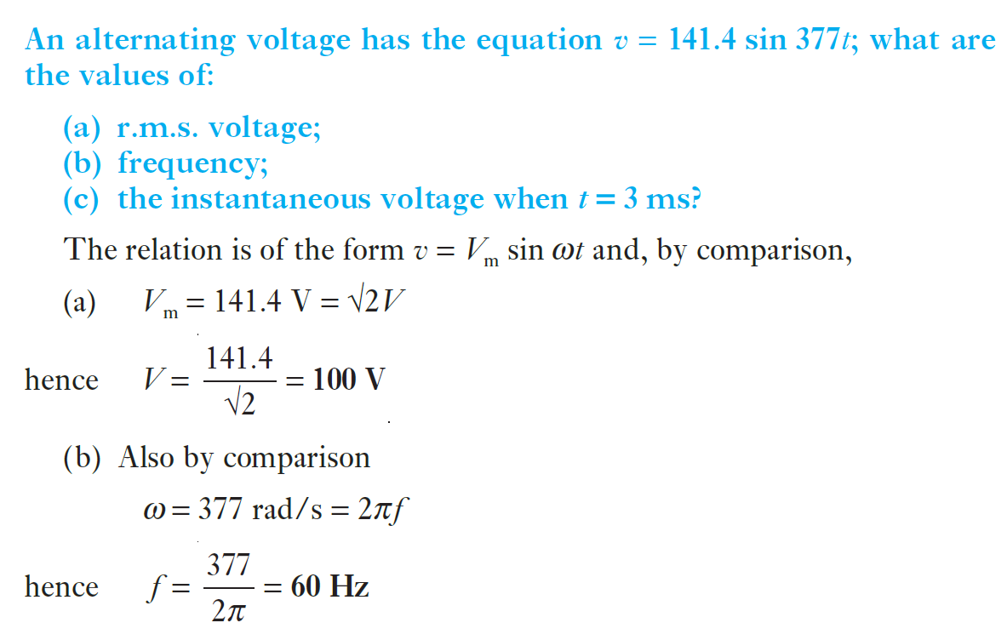
Example 2

Slide 20
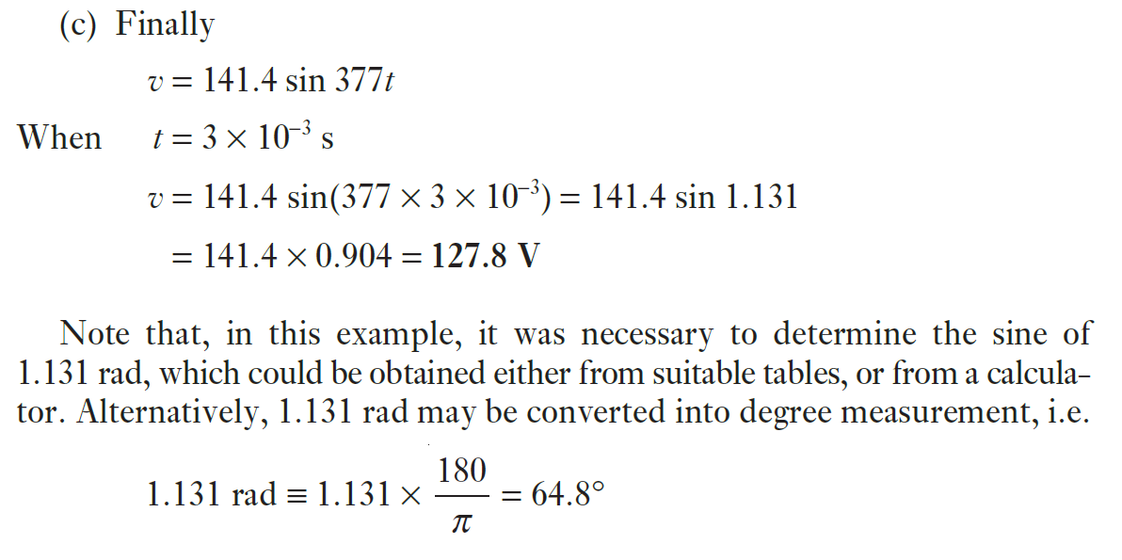
Example 2

Slide 21
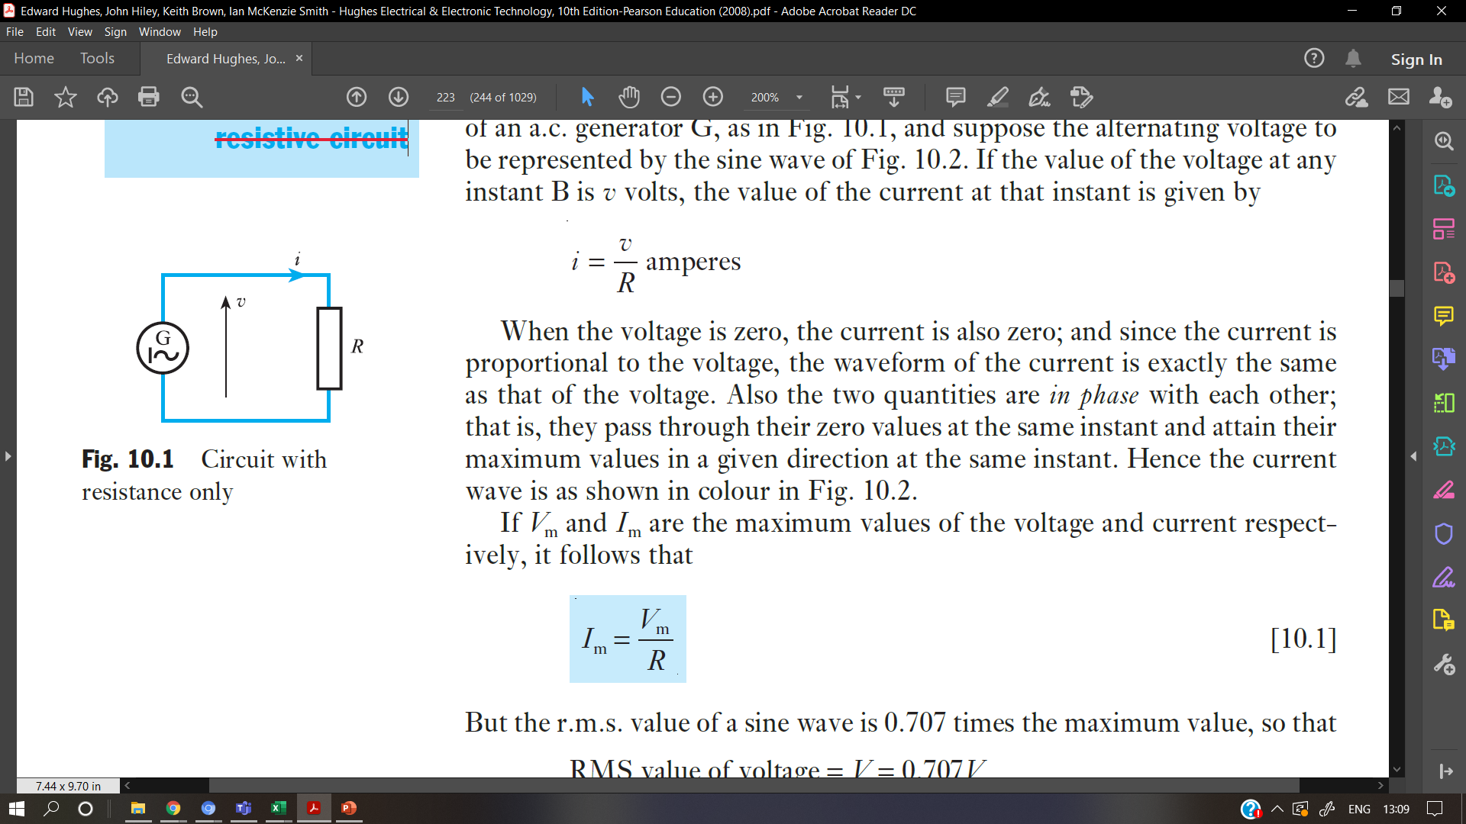
Alternating current in a resistive circuit
Consider a circuit having a resistance R ohms connected across the terminals of an a.c. generator G, as in Fig. and suppose the alternating voltage to be represented by the sine wave
If the value of the voltage at any instant is v volts, the value of the current at that instant is given by
If Vm and Im are the maximum values of the voltage and current respectively, it follows that
---------------[1]

Slide 22
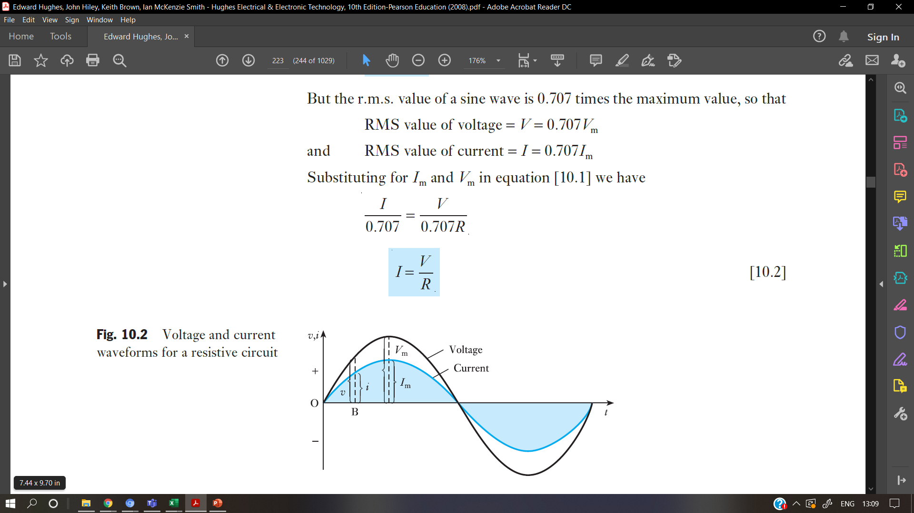
Alternating current in a resistive circuit
But the r.m.s. value of a sine wave is 0.707 times the maximum value, so that
RMS value of voltage = V = 0.707Vm
and RMS value of current = I = 0.707Im
Substituting for Im and Vm in equation [1] we have

Slide 23
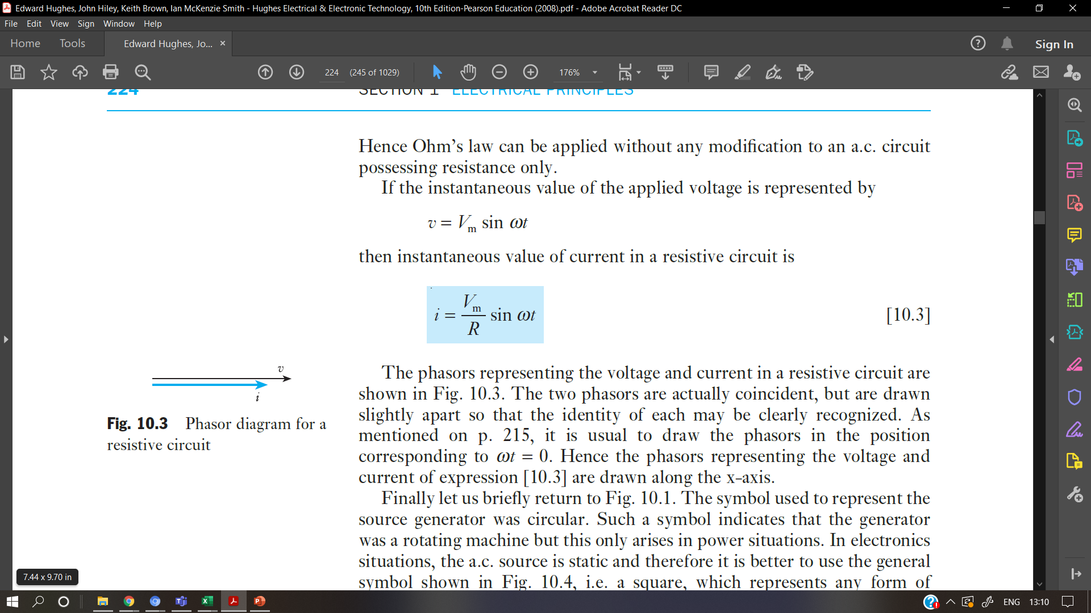
Alternating current in a resistive circuit
Hence Ohm’s law can be applied without any modification to an a.c. circuit possessing resistance only.
If the instantaneous value of the applied voltage is represented by

Slide 24
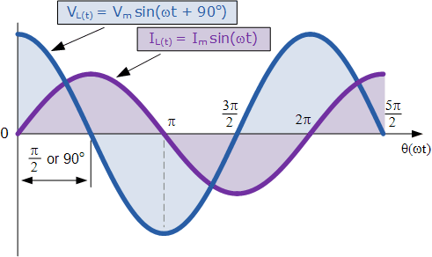
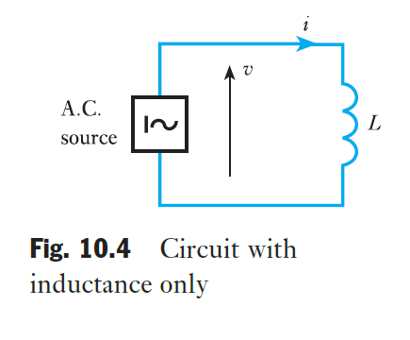
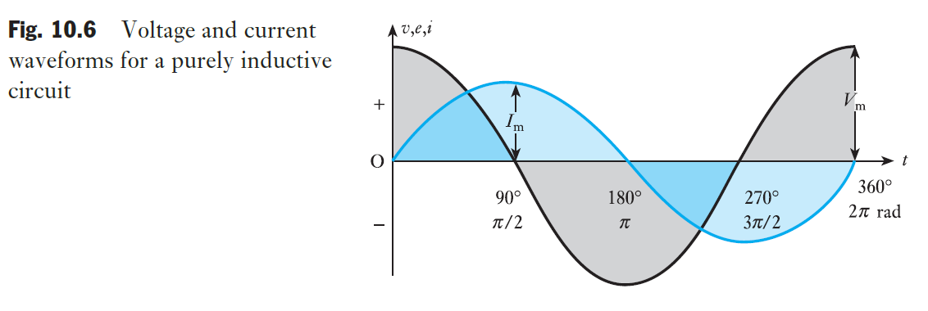
Alternating current in an inductive circuit
Let us consider the effect of a sinusoidal current flowing through a coil having an inductance of L henrys and a negligible resistance, as in Fig. the e.m.f., in volts, induced in a coil is
e = L × rate of change of current in amperes per second

Slide 25
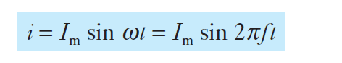
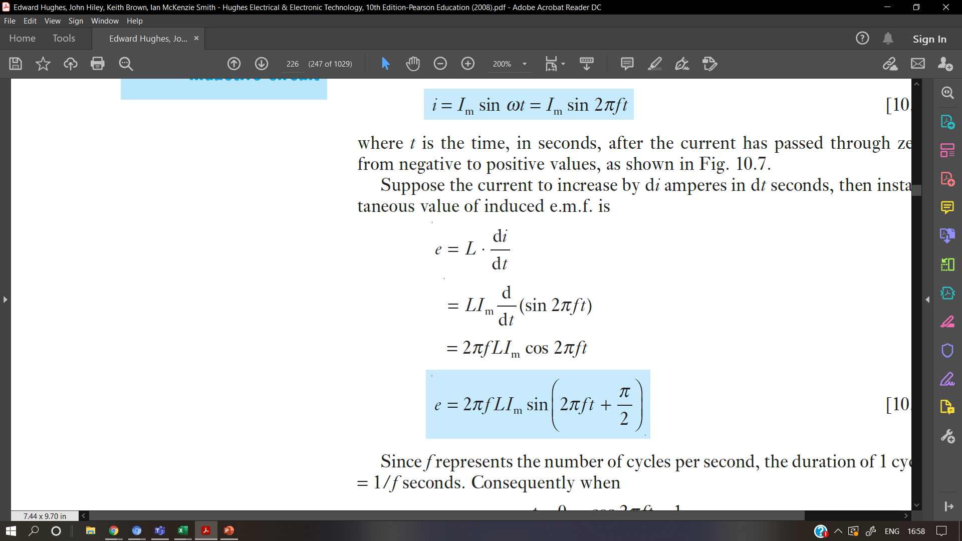
Current and voltage in an inductive circuit
Suppose the instantaneous value of the current through a coil having inductance L henrys and negligible resistance to be represented by
where t is the time, in seconds, after the current has passed through zero from negative to positive values
Suppose the current to increase by di amperes in dt seconds, then instantaneous value of induced e.m.f. is

Slide 26
"The direction of an induced current is such that it opposes the change in magnetic flux that produced it.“
Induced EMF=−dΦ/dt​
The negative sign indicates that the induced EMF opposes the change in magnetic flux.

Slide 27
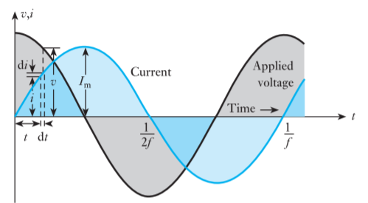
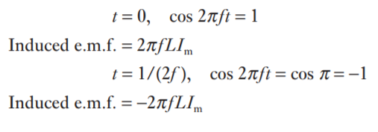
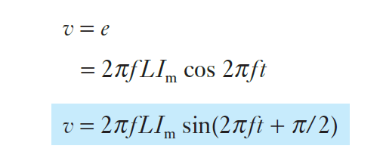
Current and voltage in an inductive circuit
Since the resistance of the circuit is assumed negligible, the whole of the applied voltage is equal to the induced e.m.f.,

Slide 28
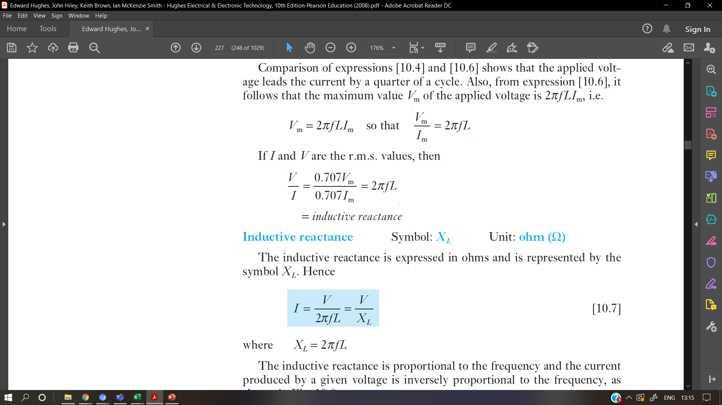
Current and voltage in an inductive circuit
The maximum value Vm of the applied voltage is 2πfLI_{m}, i.e.

Slide 29
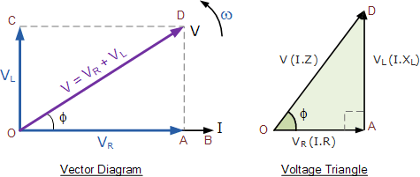
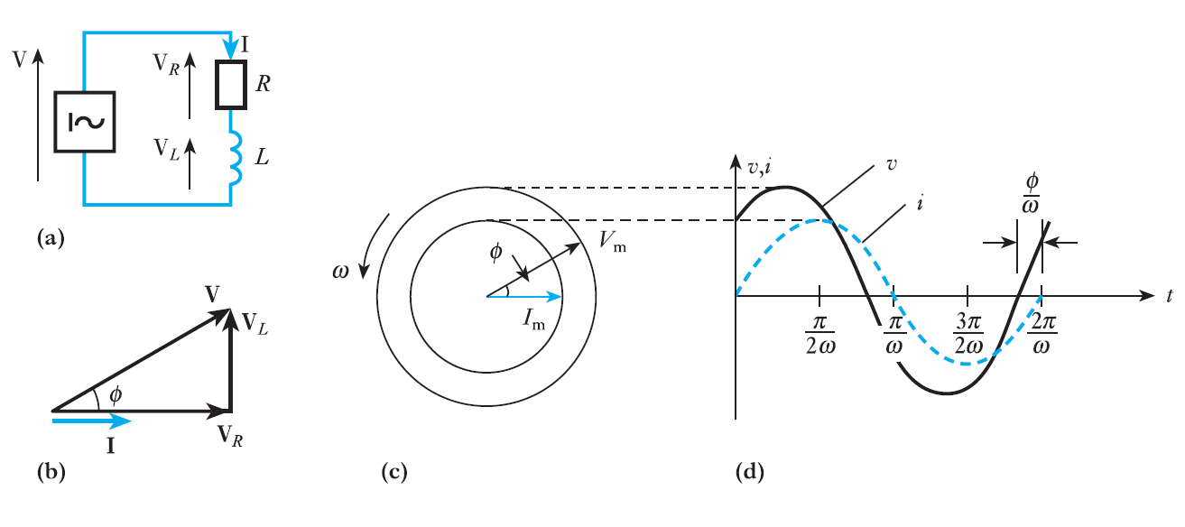
Resistance and inductance in series
Effect of Resistance and inductance connected in series.
(a) Circuit diagram; (b) phasor diagram; (c) instantaneous phasor diagram; (d) wave diagram

Slide 30
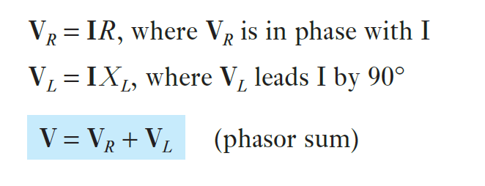
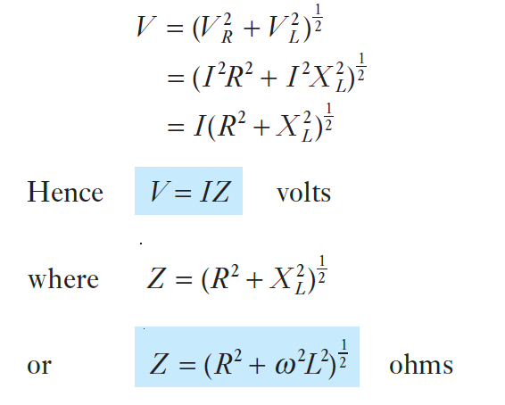
Resistance and inductance in series
The current is taken as reference since it is common to all the elements of a series circuit. The circuit voltage may then be derived from the following relations:
Also,
Here Z is termed the impedance of the circuit.
However, for any given frequency, the impedance is constant and hence Ohm’s law also applies to a.c. circuit analysis.
Impedance Symbol: Z
Unit: ohm (Ω)

Slide 31
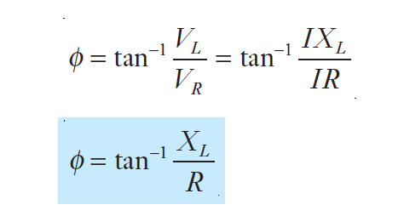
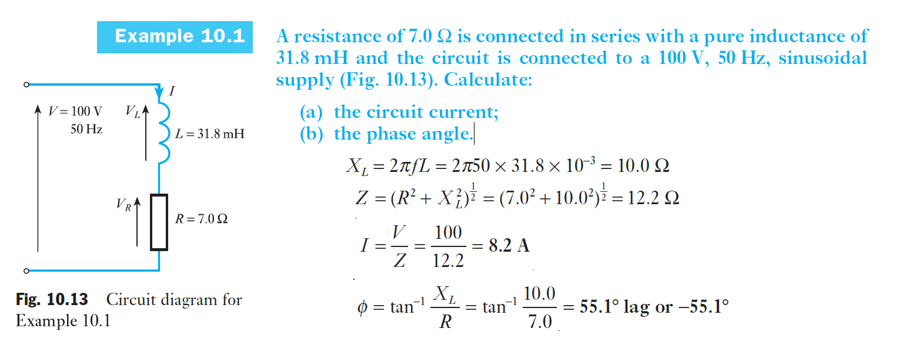
Resistance and inductance in series
Phase angle is represented by φ.

Slide 32
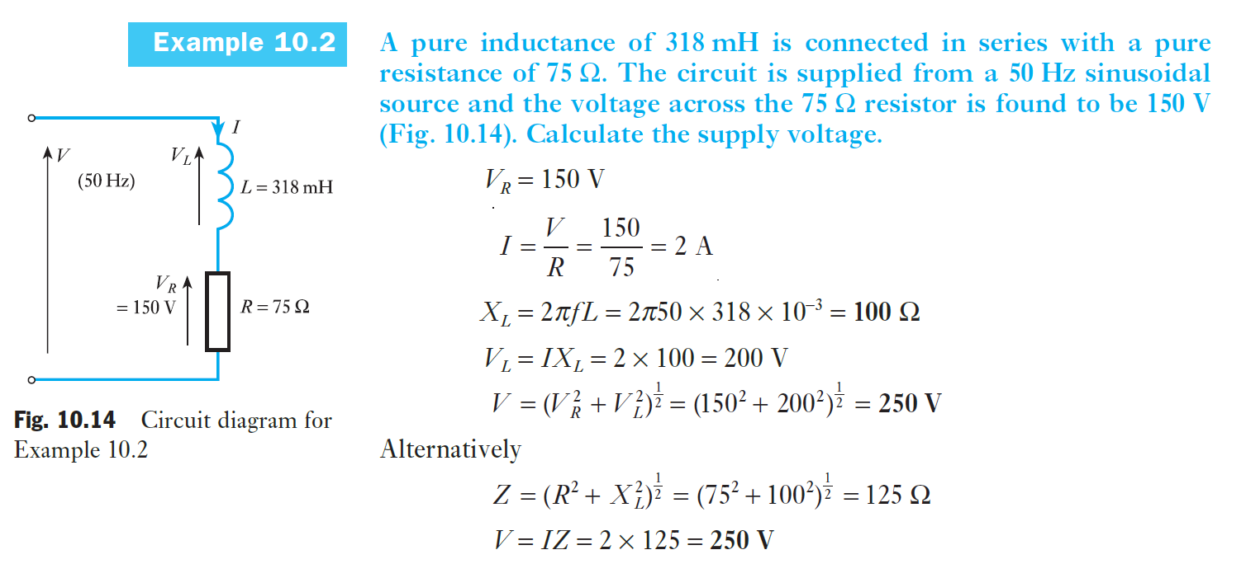
Example 4

Slide 33
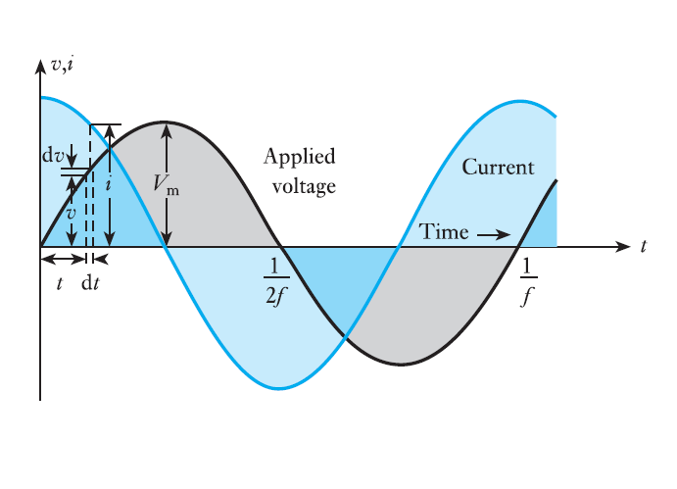
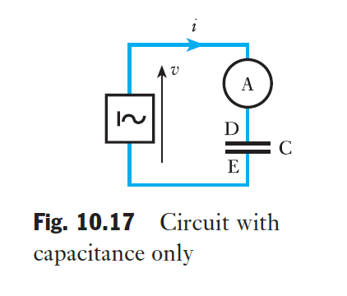
Alternating current in a capacitive circuit
Figure shows a capacitor C connected in series with an ammeter A across the terminals of an a.c. source;
The alternating voltage applied to C is positive when it makes plate D positive relative to plate E.
If the capacitance is C farads, the charging current i is given by
i = C ⋅ rate of change of p.d.
Fig. 10.18 Voltage and current waveforms for a purely capacitive circuit

Slide 34
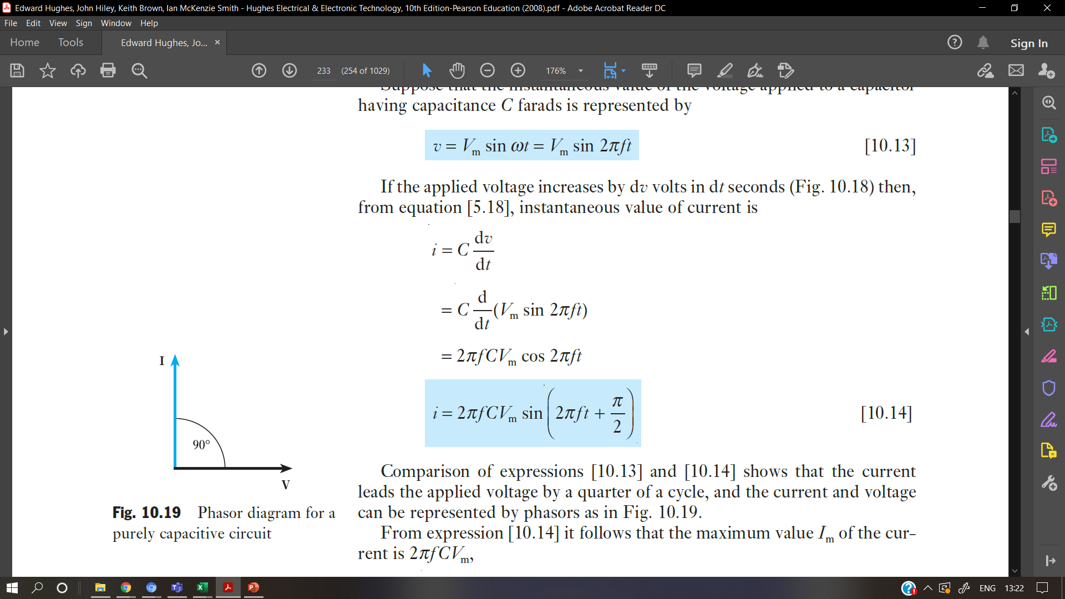
Current and voltage in a capacitive circuit
Suppose that the instantaneous value of the voltage applied to a capacitor having capacitance C farads is represented by
If the applied voltage increases by dv volts in dt seconds
then, instantaneous value of current is

Slide 35
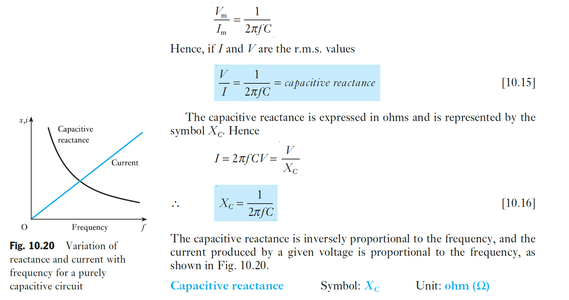
Current and voltage in a capacitive circuit

Slide 36
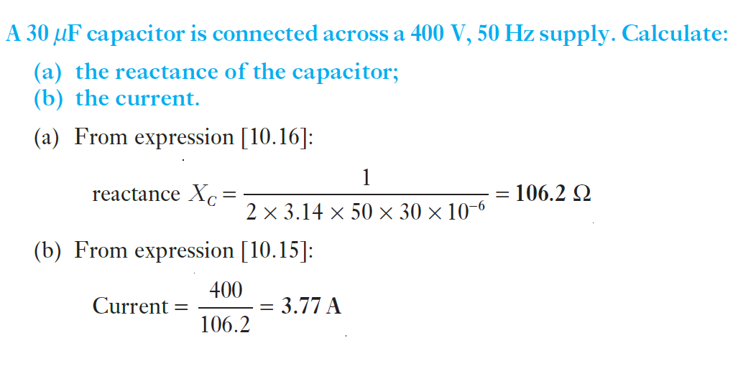
Example 5

Slide 37
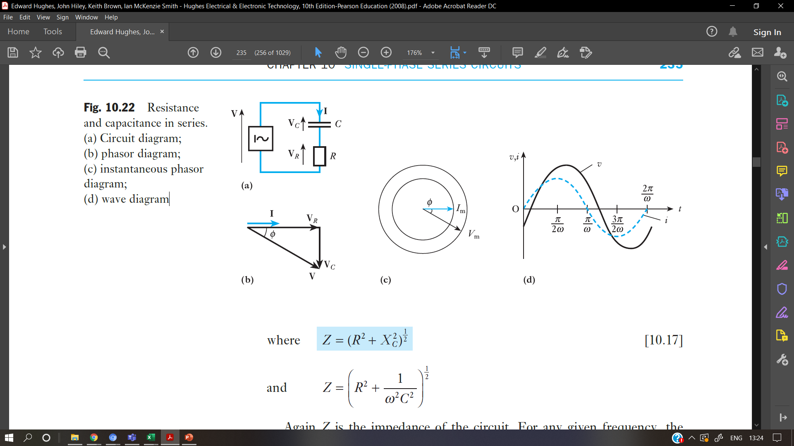
Resistance and capacitance in series
The effect of connecting resistance and capacitance in series is illustrated in Fig.
The current is again taken as reference.

Slide 38
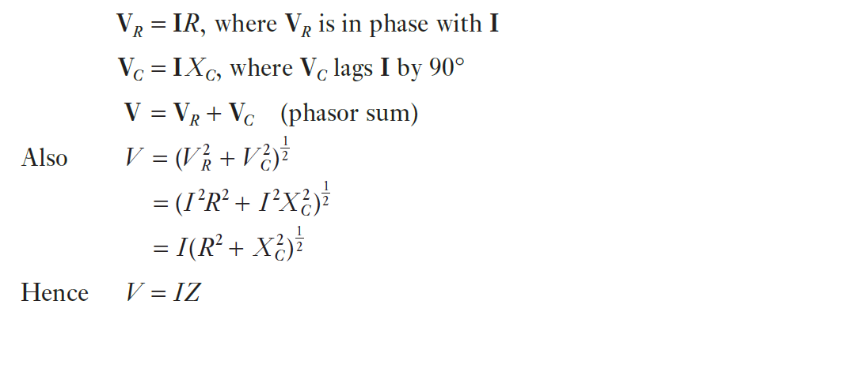
Resistance and capacitance in series
The circuit voltage is derived from the following relations:

Slide 39
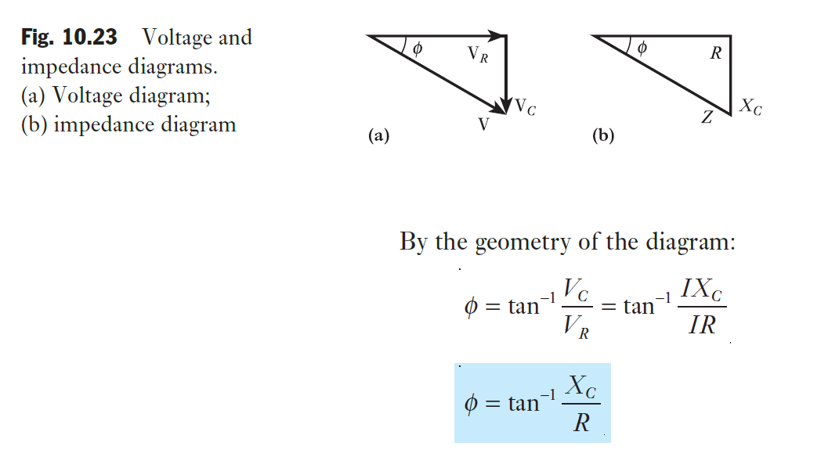
Resistance and capacitance in series

Slide 40
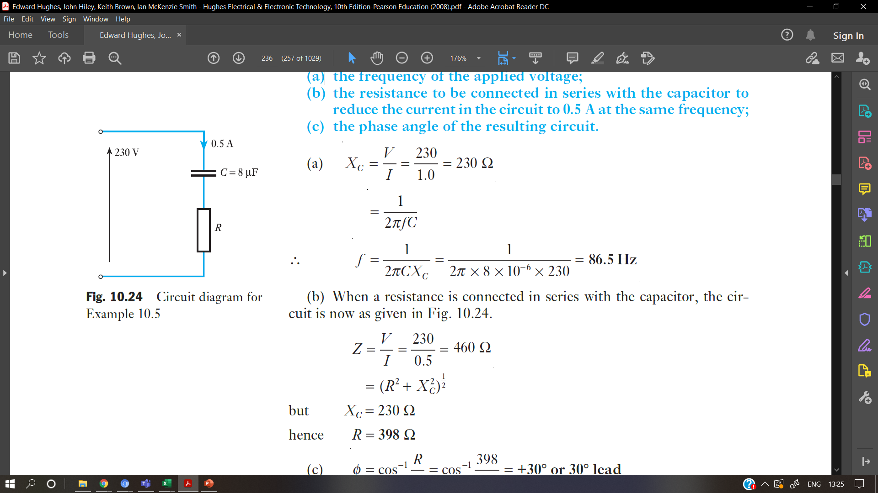
Example 6
A capacitor of 8.0 μF takes a current of 1.0 A when the alternating voltage applied across it is 230 V. Calculate:
(a) the frequency of the applied voltage;
(b) the resistance to be connected in series with the capacitor to reduce the current in the circuit to 0.5 A at the same frequency;

Slide 41
Series R-L-C circuit
Phase difference between the current through the circuit and voltages across each component
Inductive reactance and capacitive reactance values will decide the phase difference
XL= XC , When two reactances are equal, I is maximum in the circuit, only resistive network
At Resonance , XL= XC at resonant frequency , fr=1/2.pi.Root(L.C)

Slide 42
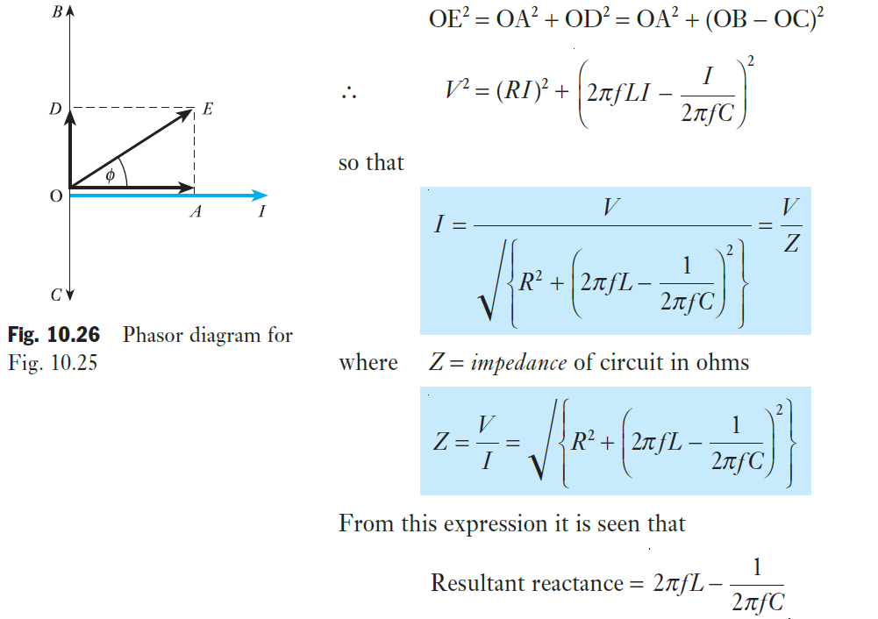


Alternating current in an RLC circuit
= inductive reactance − capacitive reactance

Slide 43

Example 7- RL circuit
A coil having a resistance of 12 Ω and an inductance of 0.1 H is connected across a
100 V, 50 Hz supply. Calculate:
(a) the reactance and the impedance of the coil;
(b) the current;

Slide 44

Example 7- RL circuit problem solution

Slide 45

Example 8
A circuit having a resistance of 12 Ω, an inductance of 0.15 H and a capacitance of 100 μF in series, is connected across a 100 V, 50 Hz supply. Calculate:
(a) the impedance;
(b) the current;
(c) the voltages across R, L and C;

Slide 46

Example 8

Slide 47


Practice problem

Slide 48

Summary of formulae

Slide 49

Admittance and conductance (1/R)
When resistors having resistances R1, R2, etc. are in parallel, the equivalent resistance R is given by
In d.c. work the reciprocal of the resistance is known as conductance. It is represented by symbol G and the unit of conductance is the siemens. Hence, if circuits having conductances G1, G2, etc. are in parallel, the total conductance G is given by
G = G1 + G2 + . . .
In a.c. work the conductance is the reciprocal of the resistance only when the circuit possesses no reactance.
If circuits having impedances Z1, Z2, etc. are connected in parallel across a supply voltage V, then

Slide 50

Admittance(1/Z), conductance
If Z is the equivalent impedance of Z1, Z2, etc. in parallel and if I is the resultant current, then, using complex notation, we have
I = I1 + I2 + . . .
The reciprocal of impedance is termed admittance and is represented by the symbol Y, the unit being again the siemens (abbreviation, S). Hence,
Y = Y1 + Y2 + . . .

Slide 51

Frequency variation in a series RLC circuit
The impedance Z of this circuit is given by
The value of the reactance X of the circuit
ωL − 1/(ωC) (i.e. inductive reactance − capacitive reactance) will depend on frequency.
For the inductive reactance:
|XL| = ωL = 2π fL
which will increase with frequency.
For the capacitive reactance:
which is largest at low frequencies.

Slide 52

The resonant frequency of a series RLC circuit

Slide 53

Single Phase Transformer
A static device which transfers electrical energy from one ac circuit to another with the desired change in voltage or current and without any change in frequency
AC device
Voltage/current can be amplified or reduced
Step-up and step-down transformer
Step-up: Step up to higher voltages for the transmission lines.
Step-down: To step the voltage down to values suitable for motors, lamps, heaters, etc.
Single phase transformer and three phase transformer
Symbol of Transformer -

Slide 54
single-phase transformers are primarily used in residential and small-scale commercial applications.
A single-phase transformer consists of two coils wound around a common iron core at its core. These coils are known as the primary winding and the secondary winding. When an alternating current (AC) flows through the primary winding, it generates a magnetic field around the iron core. This magnetic field induces a voltage in the secondary winding, allowing for the transfer of electrical energy from the primary to the secondary circuit.
use silicon steel laminations 60Hz

Slide 55

Working Principal of Single Phase Transformer
A steel core C consists of laminated sheets, about 0.35–0.7 mm thick, insulated from one another.
Coil P is connected to the supply and is therefore termed the primary; coil S is connected to the load and is termed the secondary.
The magnetic flux forms the connecting link between the primary and secondary circuits

Slide 56




Working Principal of Single Phase Transformer
An alternating voltage applied to P circulates an alternating current through P and this current produces an alternating flux in the steel core
If the whole of the flux produced by P passes through S, the e.m.f. induced in each turn is the same for P and S.
Hence, if N1 and N2 are the number of turns on P and S respectively,
Primary and secondary power factors are nearly equal,
Current ratio is given by:

Slide 57


